Slide 1
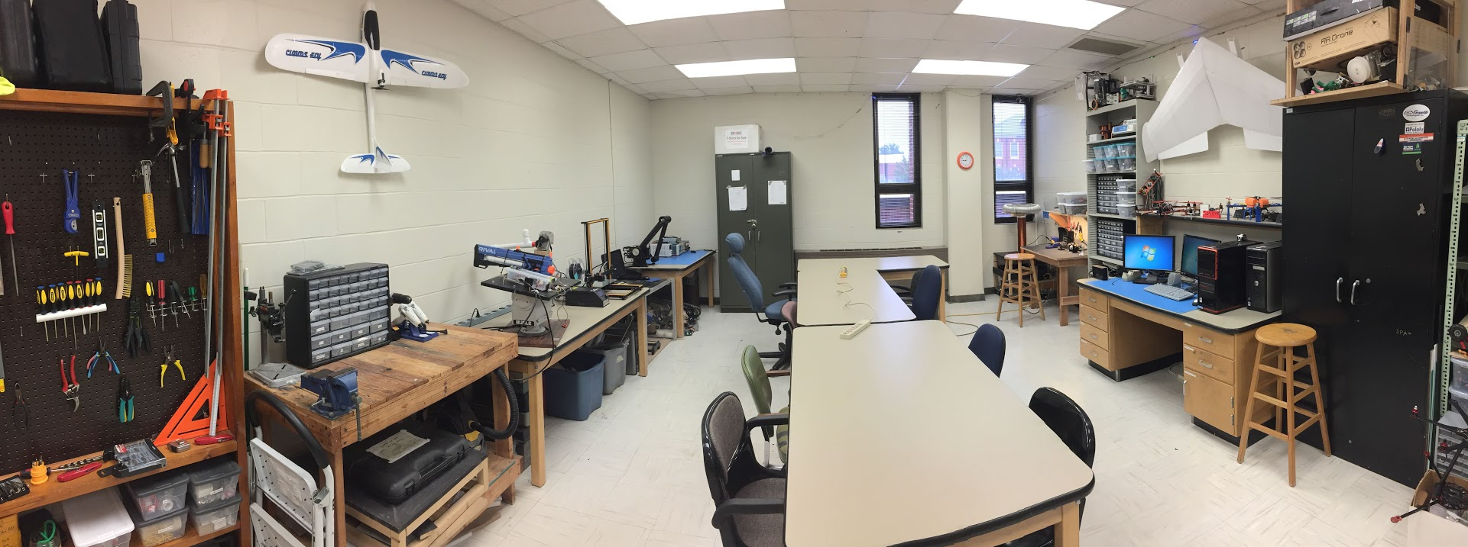
ABOUT SPARC
Creates and fosters an environment of creativity and innovation through collaborative projects.
A place to test out ideas, integrate concepts learned in class, and learn skills that will be instrumental when working in the workforce.
No prior experience is required, only a willingness to learn.
Lab:
- Broun 367
General Meetings:
- Tuesdays @ 6 in Broun 125
Project Meetings:
- Various Times during week

Slide 2
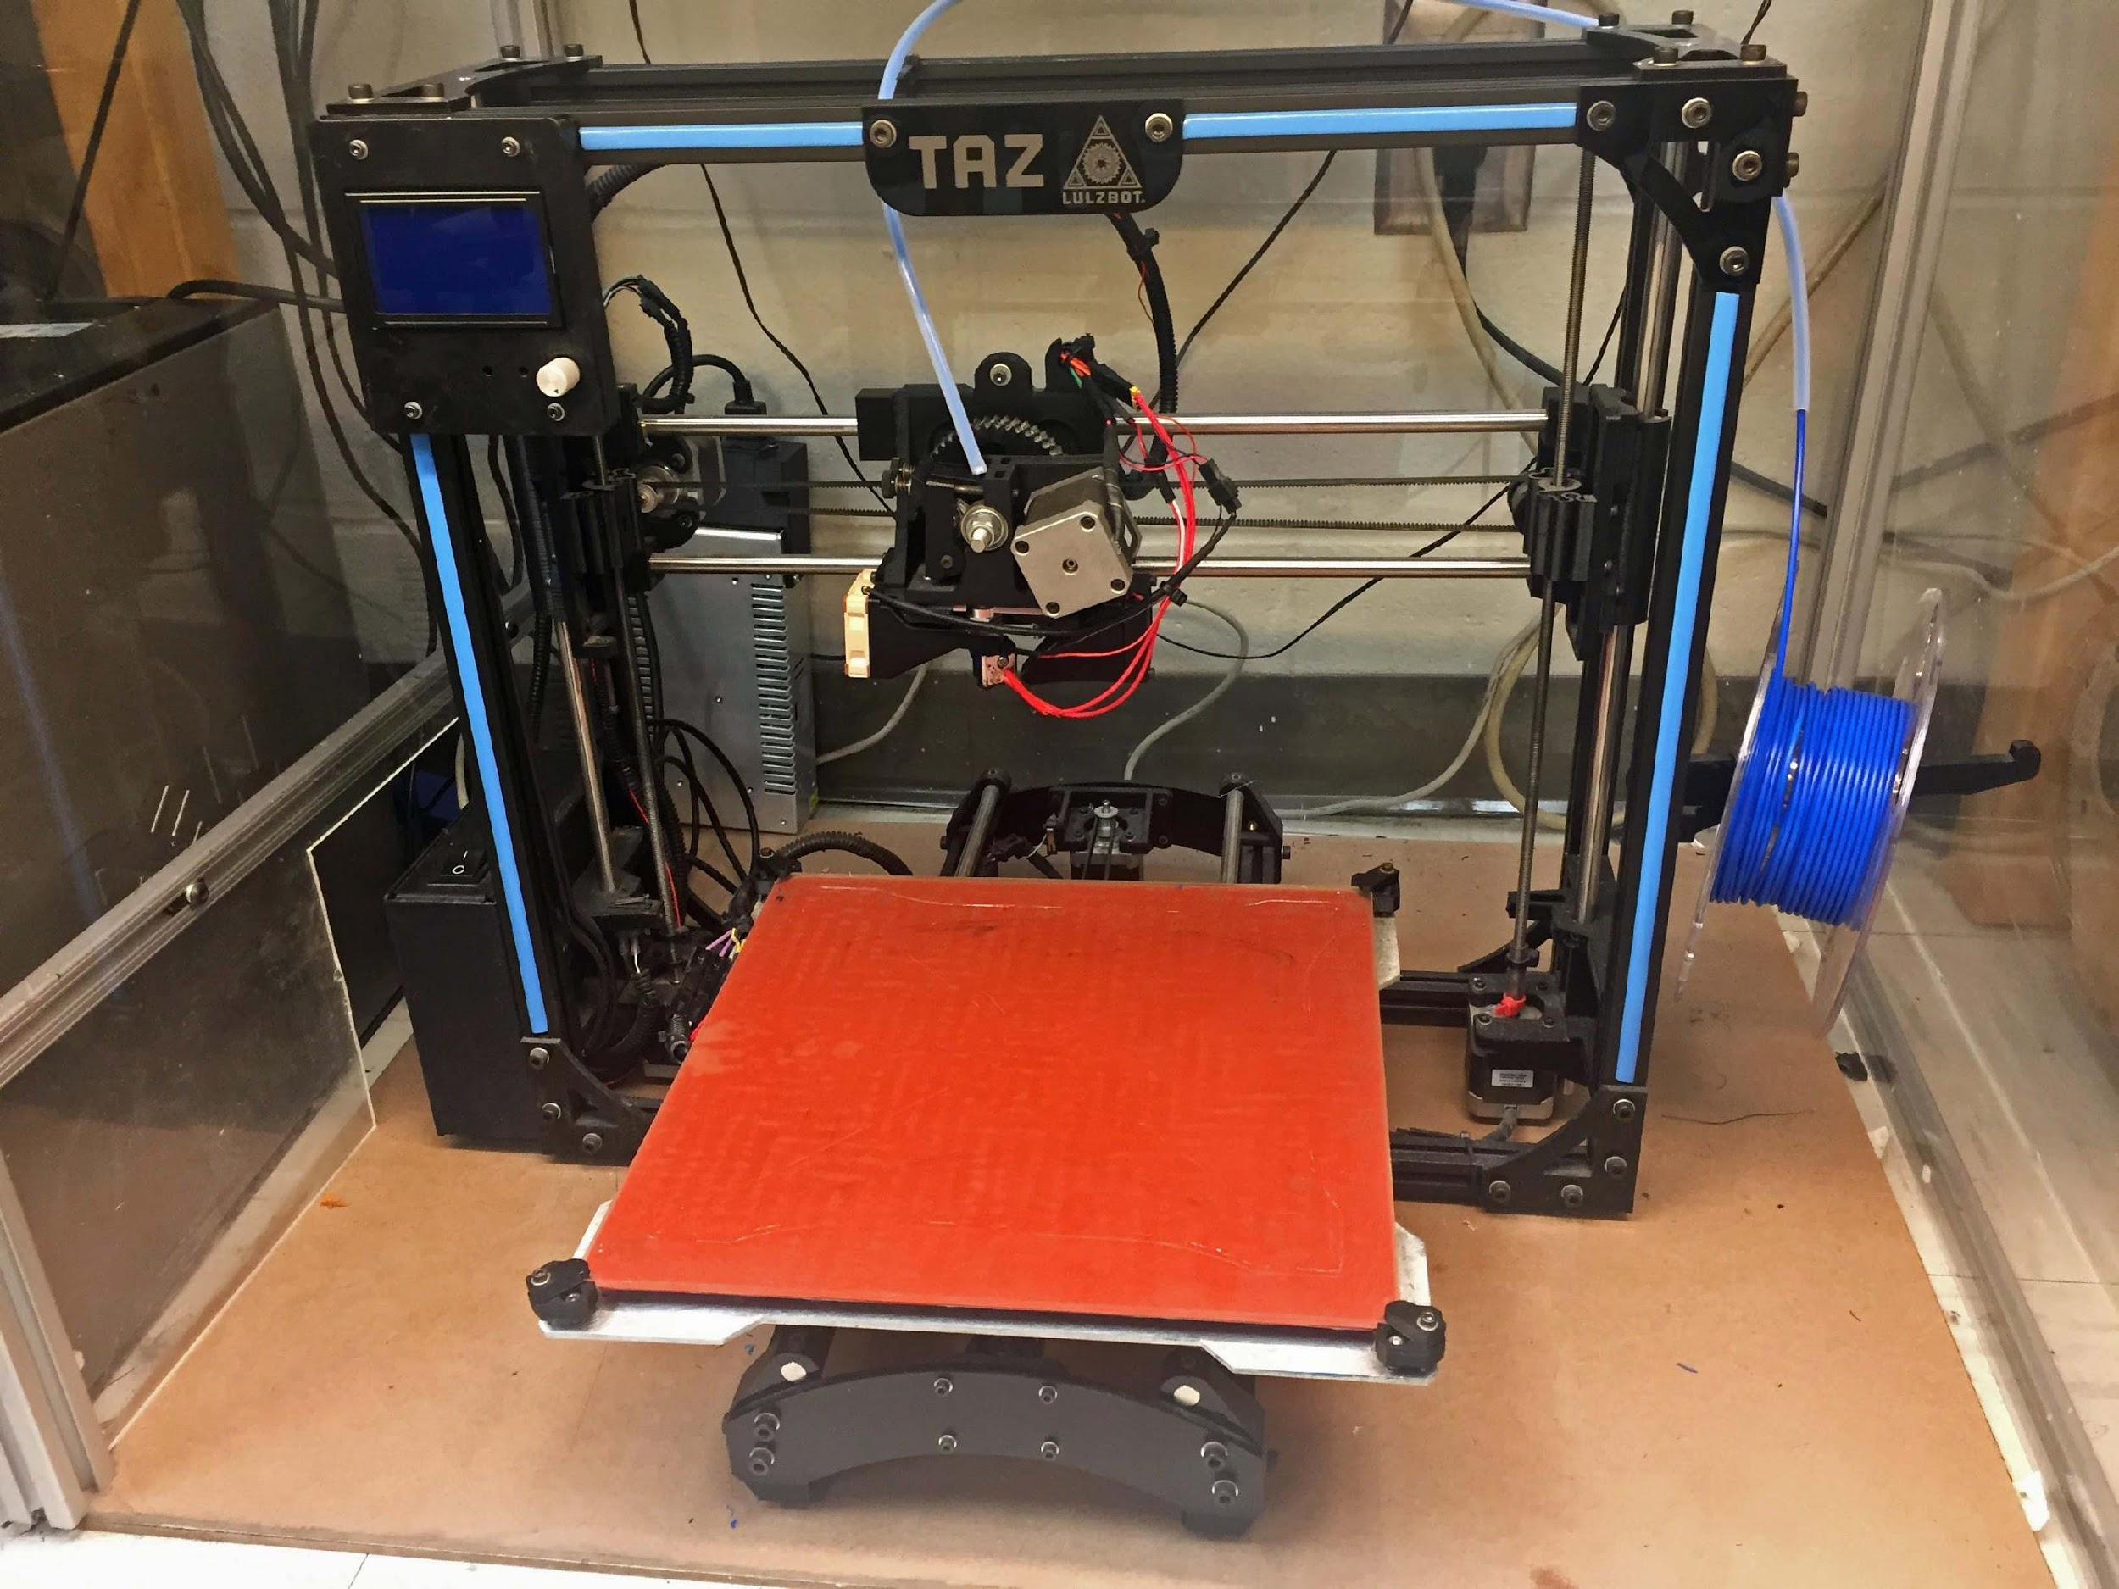
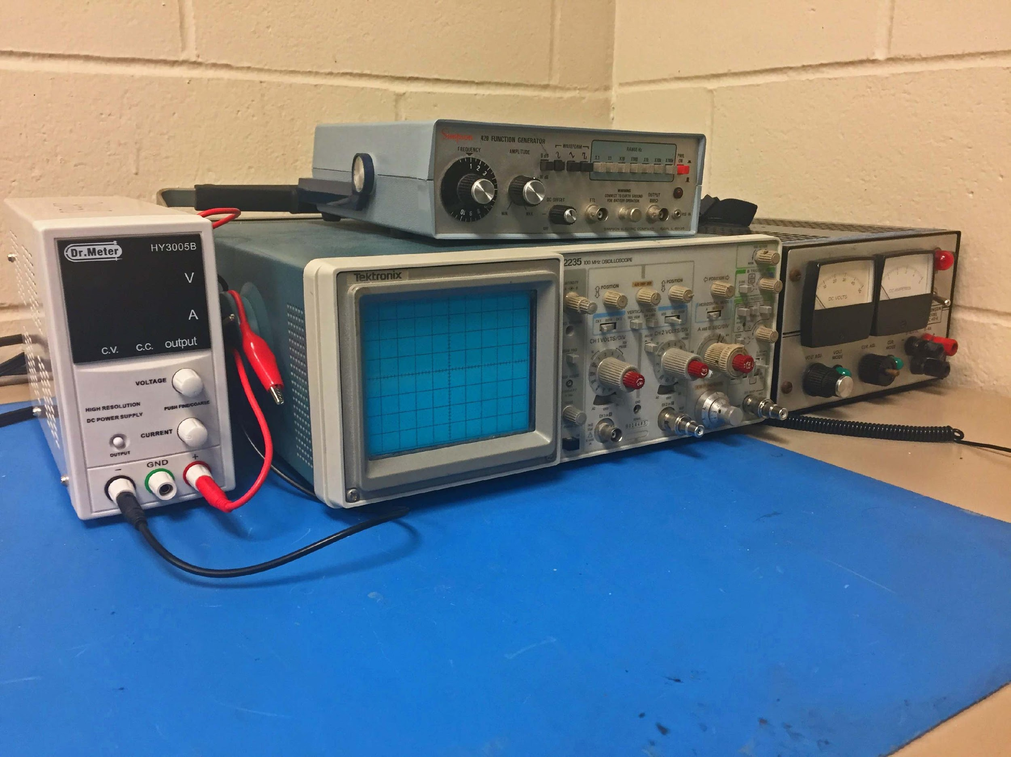
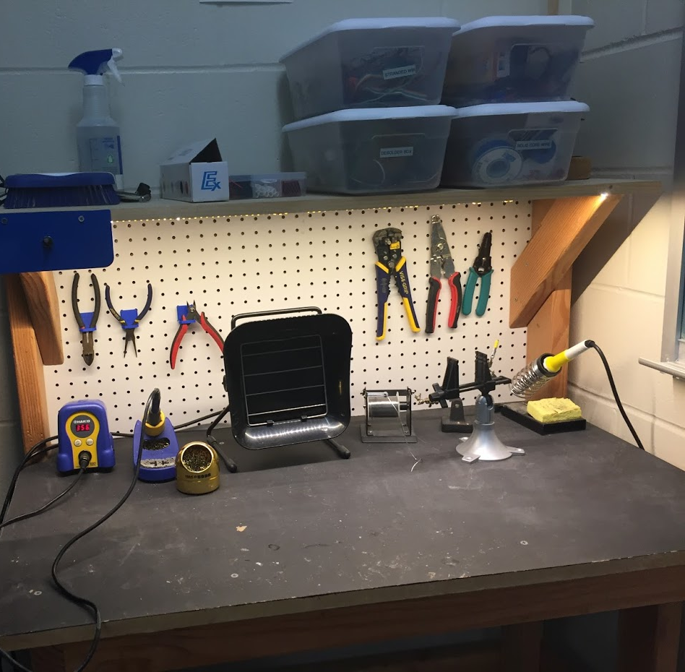
OUR LAB
Broun Hall
Room 367

Slide 3
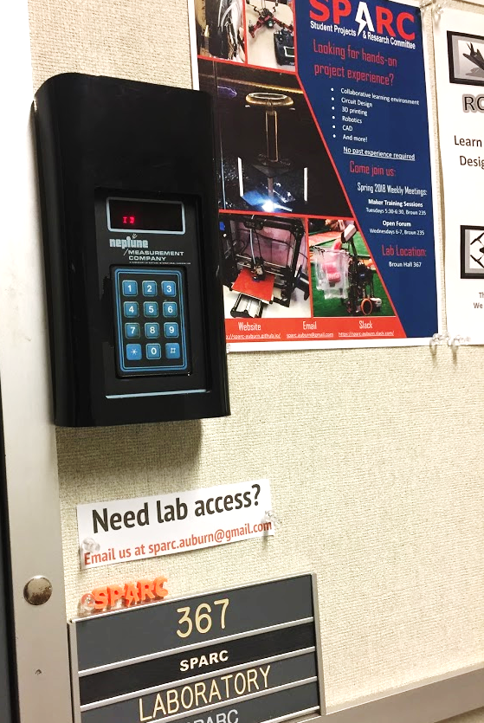
HOW TO BECOME A MEMBER
Log 5 constructive hours in the lab
Write the times on the sheet on the clipboard next to the door.
Contact us at sparc.auburn@gmail.com
We will respond with the instructions to get an access code.

Slide 4
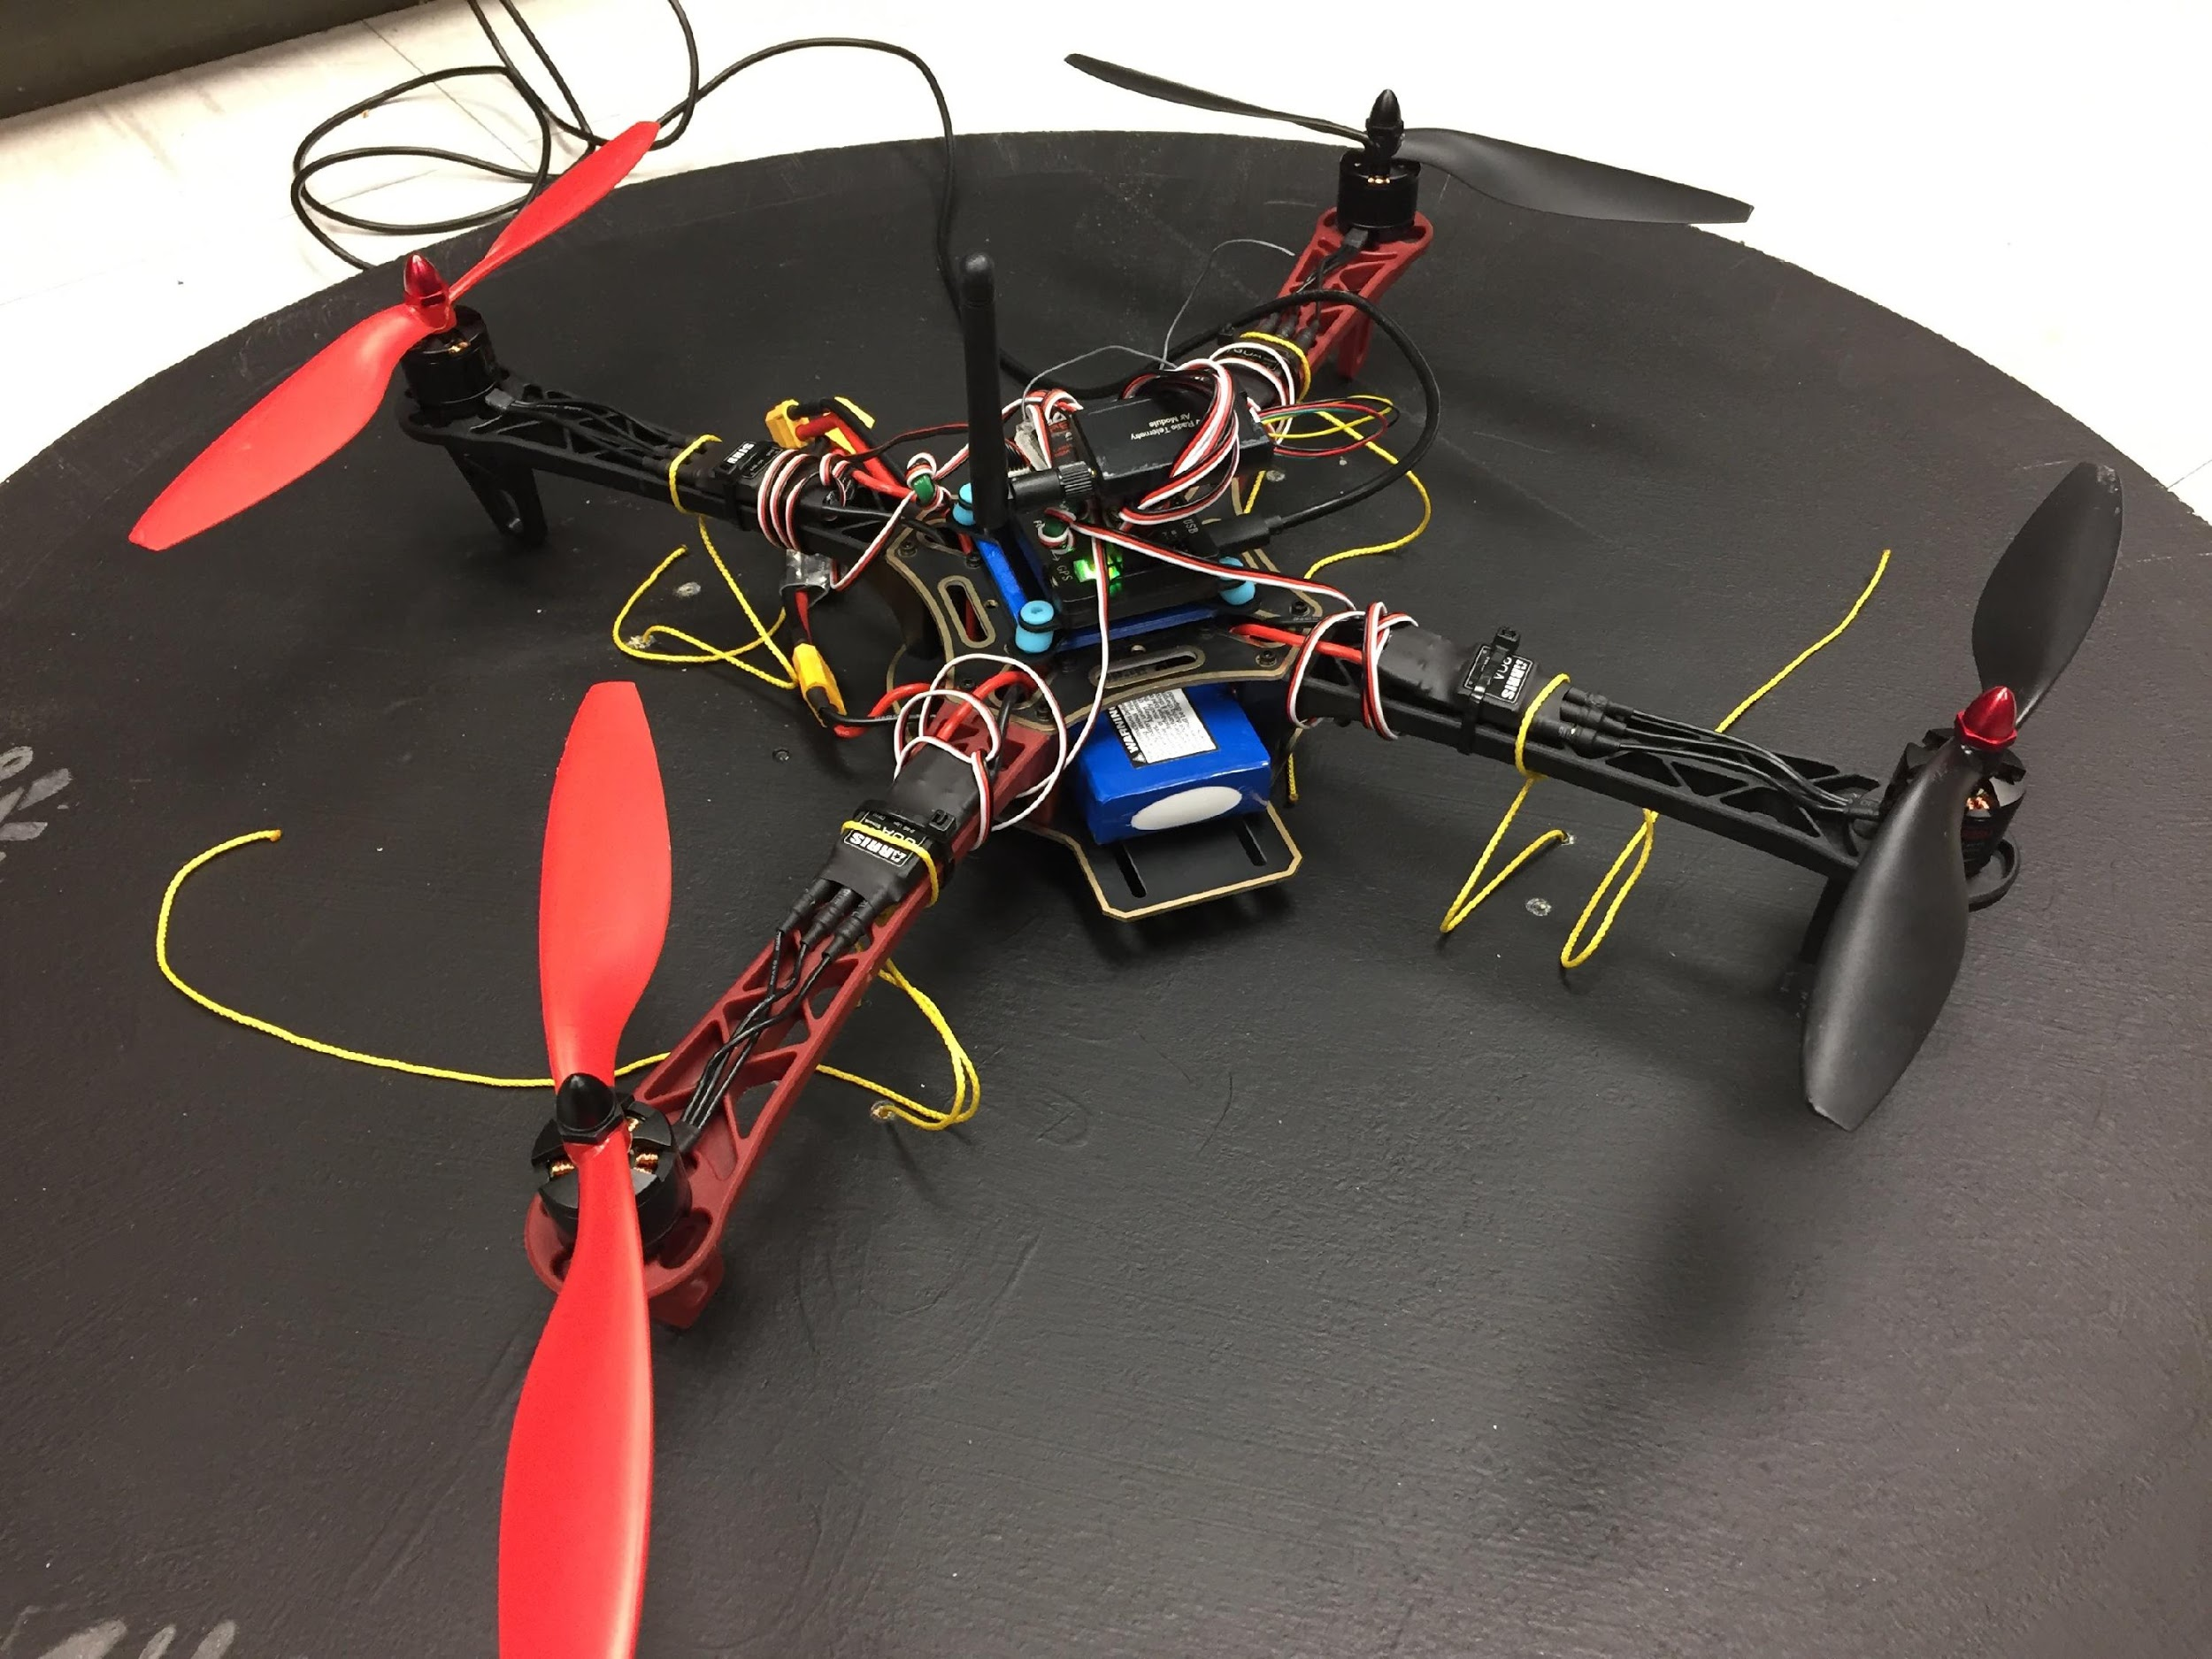
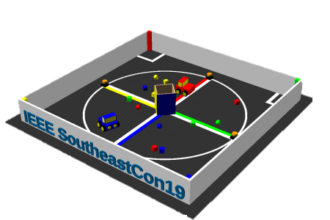
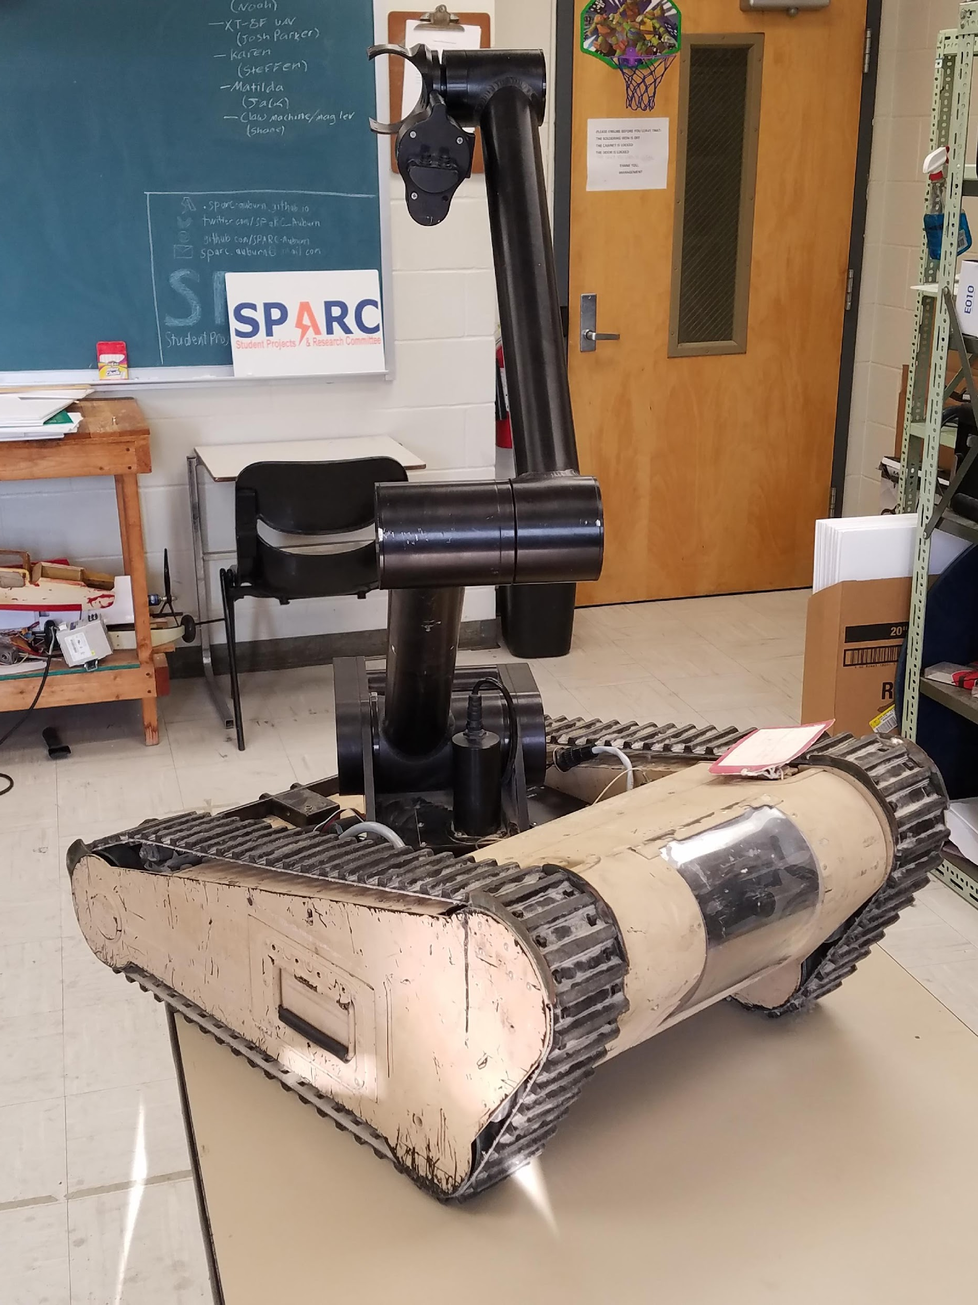
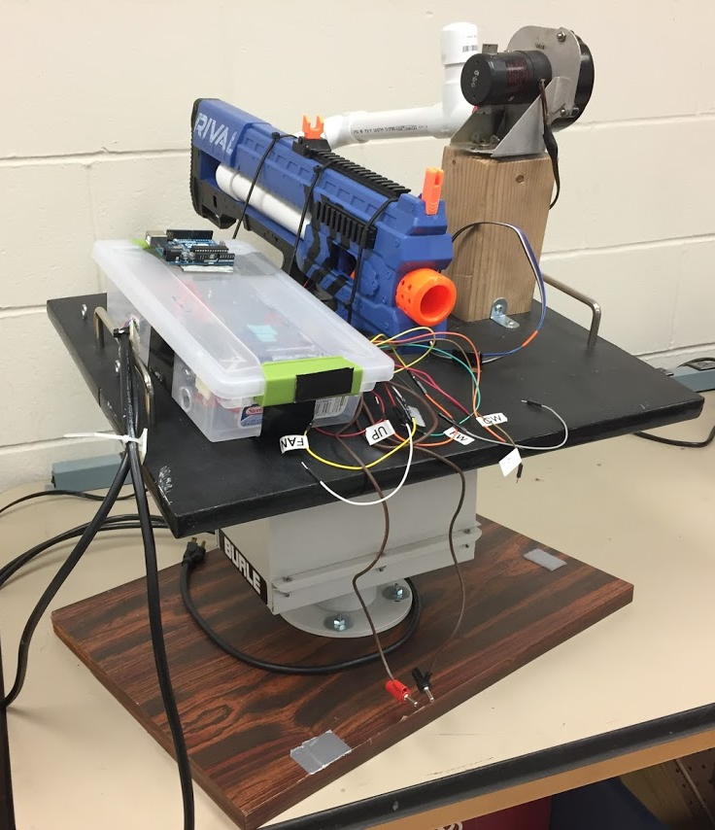
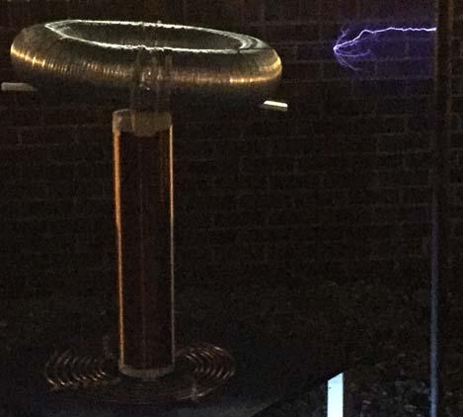
Projects
Active Projects:
IEEE
Southeastcon Robotics Team
Bomb Disposal Robot Reverse Engineering
Quadcopter Package Delivery System
NERF Turret
Tesla Coil
3D Printer Enclosure

Slide 5




MORE INFORMATION ABOUT SPARC
Website
http://sparc.eng.auburn.edu/
Github
https://github.com/SPARC-Auburn
Slack
https://sparc-auburn.slack.com/
Email
sparc.auburn@gmail.com

Slide 6
QUESTIONS?

